Slide 1
Update on UBC’s new website and other communications and marketing measures
Executive Board meeting in Kaunas 7 June 2016 Irene Pendolin, UBC Communications Manager

Slide 2
Contents
The New UBC website is now open
New visual outlook of the UBC is defined in the brand tool kit
Next Steps in the communications and marketing renewal
Please note: Accompanying audio file for the UBC Board meeting in Kaunas (7 June 2016) is available for download at: https://www.dropbox.com/sh/i20czh6i0gno92i/AAAZO4pQ1B4ER5Tt-pevSTGNa?dl=0

Slide 3
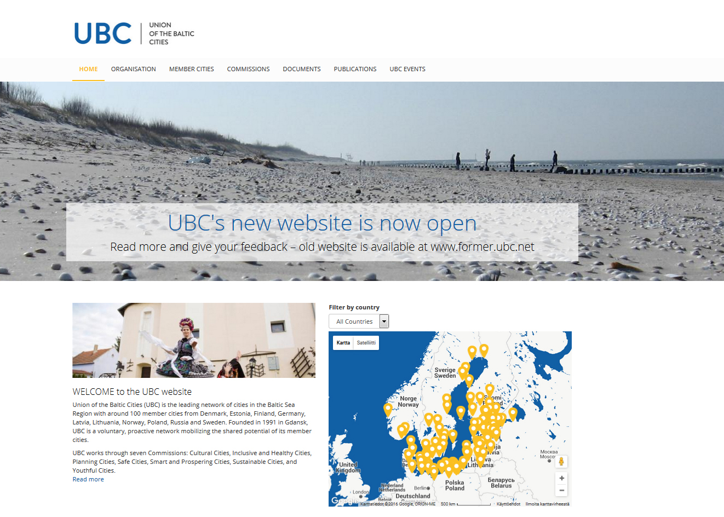

Slide 4
The new www.ubc.net
Launched on Friday 3 June 2016. Not a final version – is constantly developed.
Some of the information (member cities' information, documents etc.) is still being added and updated.
We would value feedback on the website from the member cities and commissions to ensure we have accurate information online and to make the website serve the UBC community even better.
Please send all questions and comments to UBC Communications Manager Irene Pendolin: irene.pendolin@ubc.net
You can also fill out a form at www.ubc.net
While we continue to develop the new website, the old UBC website will operate alongside for some time at www.former.ubc.net. We will mainly update the new website.

Slide 5
A brief walk-through of the website
Main page – http://ubc.net/
Carousel slides: UBC’s top news and contents we wish to highlight
Main menu: Organisation – Member Cities – Commissions – Documents – Publications – UBC Events
Introduction + map of the UBC cities
“New at UBC” – changing newsfeed – you can view news and events from the UBC and member cities, as well as projects
“Lifts” – more static information, e.g. how to join the UBC and the work done in the commissions.
“Footer” (at the bottom of all pages) – UBC’s contact information and links

Slide 6
A brief walk-through of the website
Organisation – http://ubc.net/organisation
Introductions of the UBC actors
Member cities – http://ubc.net/cities
Important information of the member city + news, events and projects
The more the cities publish their news, events and projects, the more they will be visible on the UBC website, e.g. on the main page.
http://ubc.net/cities/liepaja
http://ubc.net/cities/turku
http://ubc.net/cities/kaunas
Commissions – http://ubc.net/commissions
All commissions have their own pages + Working Group on Gender Equality and UBC Communications Network
Some information from the Commissions is yet to be added – please contact Communications Manager Irene Pendolin

Slide 7
A brief walk-through of the website
Documents – http://ubc.net/document-categories
The same as the old Documentation Centre
A lot of the documents still need to be added
You can access documents also at the old website: www.former.ubc.net
Publications – http://ubc.net/publications
Baltic Cities Bulletin
The first BCB with a new visual outlook has just come out
The new visual look is consistent with the new UBC website
We will continue to develop the Bulletin after this first issue with the new look
Pdf and possibility to open in reader (ISSUU)
UBC Events – http://ubc.net/ubc-events
Calendar and list view, upcoming and past events
More events will be added continuously.
Events will appear on the main page and the cities’ pages

Slide 8
New visual outlook of the UBC is defined in the brand tool kit
http://ubc.net/commissions/ubc-communications-network/materials
Defines how to use the UBC logos
Main logo
Marketing logo
Commissions’ logos
Defines UBC’s other graphical elements such as typography and colors
The new visual outlook of the UBC still needs to be communicated to the commissions and member cities.

Slide 9
Next Steps in the communications and marketing renewal
Information about the new website has been sent to the member cities and commissions + post on Facebook
More information to the commissions and cities will follow as soon as possible, e.g. the new visual outlook of the UBC
Information on the new website will be added and updated in collaboration with the member cities and commissions
Next steps defined in the contract with advertising agency KMG:
Possibility of intranet
General brochure for the UBC
Templates (PowerPoint, visit cards etc.)

Slide 10
Thank you!
Comments, questions, ideas? Please be in touch!
Irene Pendolin Communications Manager irene.pendolin@ubc.net +358 40 848 6242

