Slide 1
UBC Smart and Prospering Cities Commission network I learn I do
Stockholm, 10th November 2016

Slide 2
Agenda
Focus
Achievements
Challenges

Slide 3
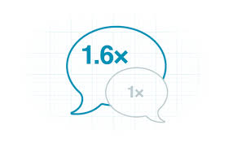
Focus
Network
Learn
Do
Administration
Business
Academia
Innovation
Attractiveness
Creative Ports
Exchanges

Slide 4
Challenges
1
UBC Strategy
2
Marketing
3⁺
Members

Slide 5
UBC Smart and Prospering Cities Commission
Wolfgang Schmidt
Chairman
T + 49 431 901 1005
wolfgang.schmidt@kiel.de

