Slide 1






Digital Youth Center
in Klaipėda & Liepāja
Interreg VI-A Latvia–Lithuania Cross-Border Cooperation Programme 2021–2027
1/8

Slide 2


















Project Overview
Digital Youth Center Concept Development in Klaipėda and Liepāja
Budget Information
Programme: Interreg VI-A Latvia–Lithuania Cross-Border Cooperation Programme 2021–2027
Total Budget: €416,727.50
EU Funding:
€333,382.00
Project Duration: June 1, 2025 – May 31, 2027
Co-financing:
€83,345.50
Project Partners
Klaipėda City Municipality (Lithuania)
Liepāja City Municipality (Latvia)
Youth Development Platform YOU+ (Latvia)
NGO Youth Personal Development Center (Lithuania)
2/8

Slide 3






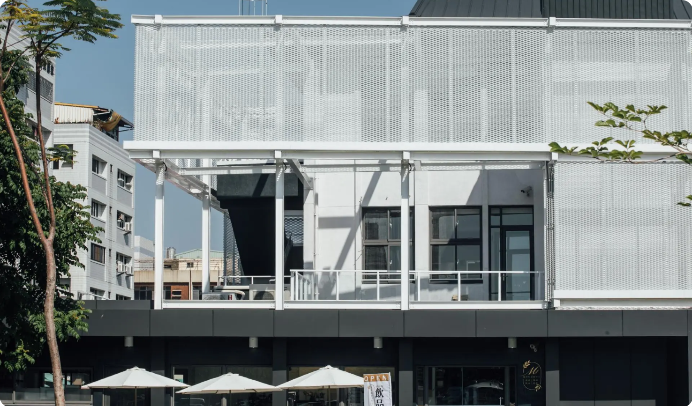













Project Aim
To develop a Digital Youth Center concept in Klaipėda and Liepāja, aimed at engaging young people with fewer opportunities and those at social risk by providing them with an inclusive space for communication, connection, and access to tailored social services.
Digital Youth Center
Target Beneficiaries
Creating a model for a digital center that combines traditional youth work with modern digital practices
Engaging young people with fewer opportunities and those at social risk
Inclusive Space
Social Services
Cross-Border Cooperation
Providing a welcoming environment for communication and connection
Offering tailored support services including cmental health ounselling and career guidance
A collaborative initiative between Lithuania and Latvia to address common challenges in youth work
3/8

Slide 4





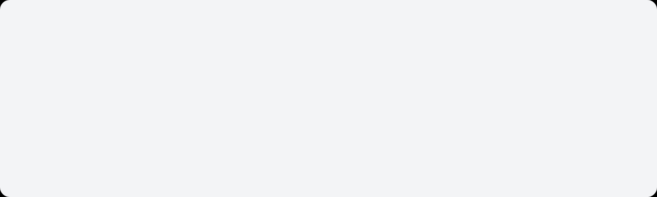










Target Groups
Young People
Youth Workers
Young people, especially those facing social exclusion or vulnerability
Youth workers, supporting and engaging youth in digital environments
Key Characteristics:
Socially excluded youth
Vulnerable individuals
Active in digital environments
Project Focus:
Support Areas:
Providing an inclusive space for communication and access to tailored social services
Digital youth work training
Counselling services
Addiction prevention
Career guidance
4/8

Slide 5

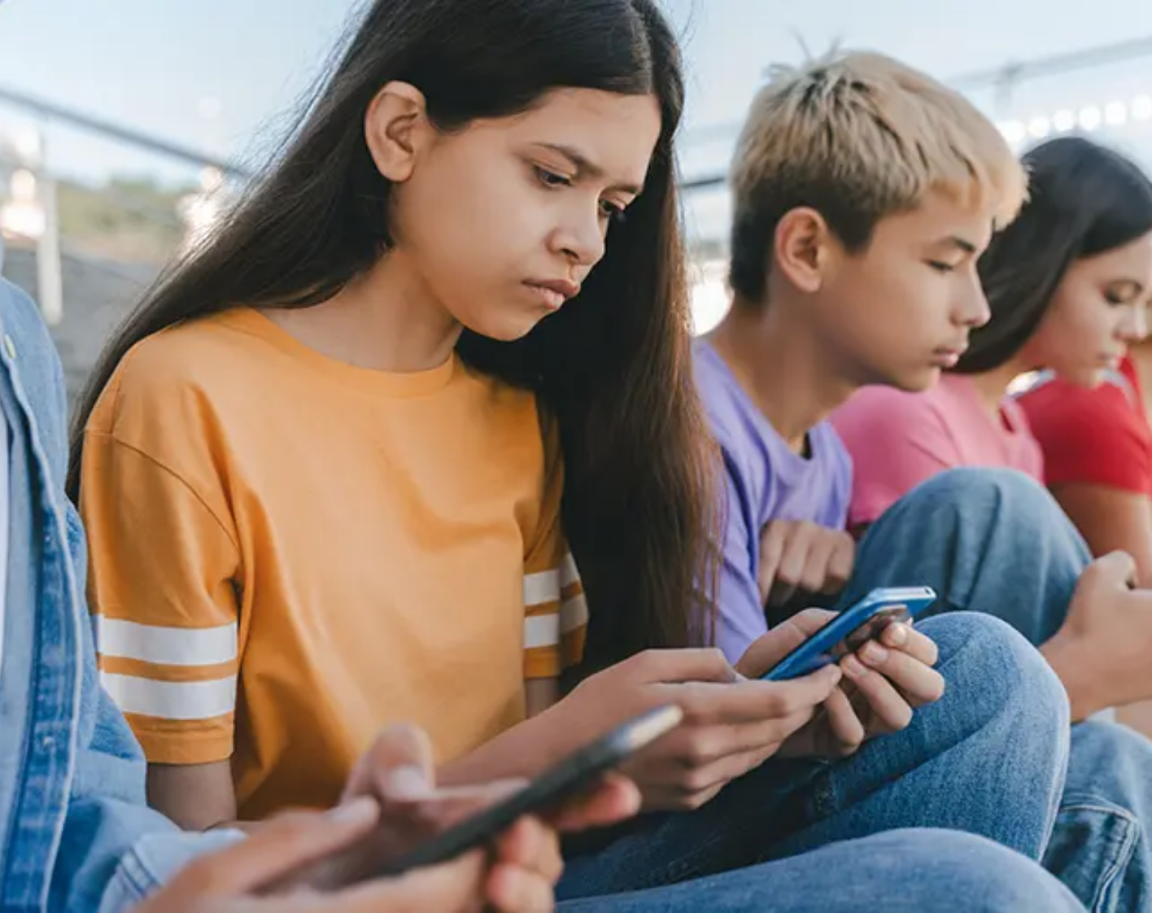














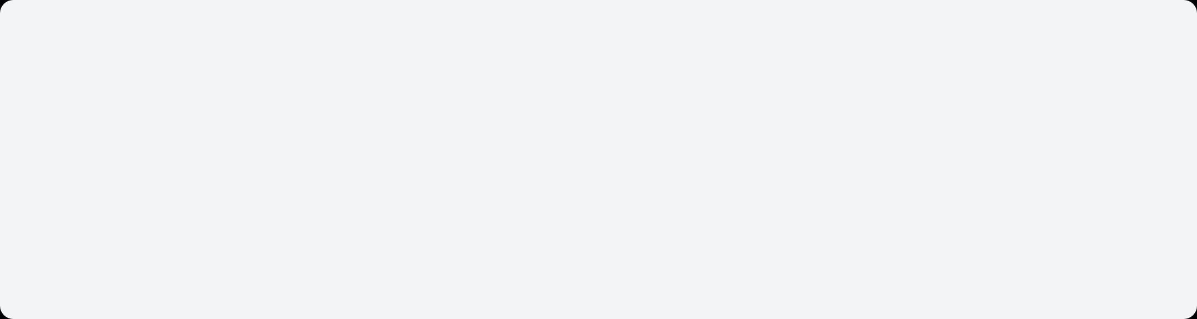



Background and Challenges
Key Challenges
Cyberbullying & Disinformation
Digital Dependency
Risk of excessive screen time and digital dependency
Increased exposure to cyberbullying and disinformation online
Digital Challenges
Social Isolation
Digital Skills Gap
Young people face numerous challenges in the digital world
Social isolation due to lack of real-life interaction
Insufficient digital skills among youth workers
Cross-Border Challenge
Impact on Youth Work
Both Lithuania and Latvia face similar challenges in youth work, particularly in reaching socially excluded young people who spend a significant amount of time online.
Limited effectiveness of traditional youth work methods in digital contexts
Need for innovative approaches to engage socially excluded young people
Requirement for digital literacy and online safety skills
5/8

Slide 6

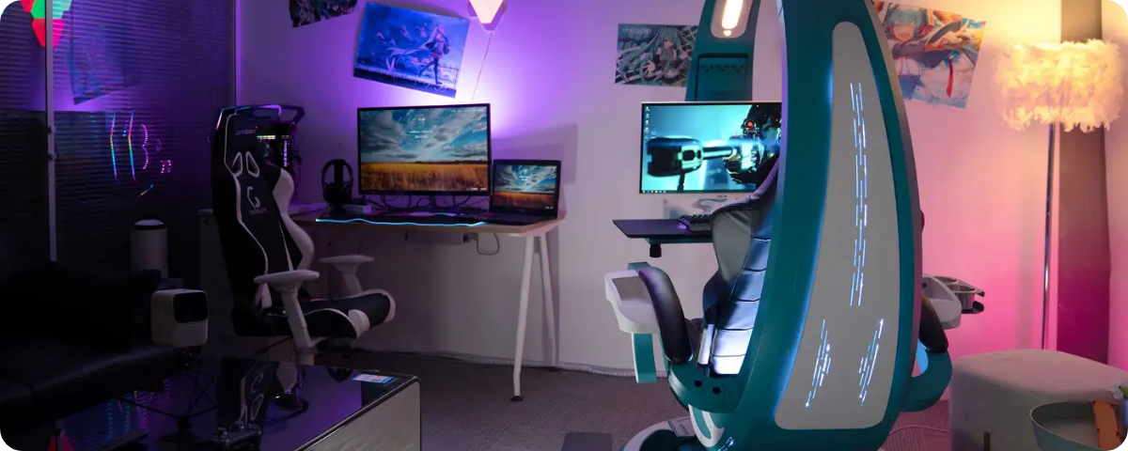


















Project Activities
Develop Digital Youth Center Model
Renovate Youth Spaces
Create a comprehensive model for Klaipėda and Liepāja that addresses the needs of young people with fewer opportunities.
Support the renovation of youth spaces in Liepāja to create a welcoming and inclusive physical environment for digital activities.
Create Inclusive Online Environment
Equip Modern Gaming Stations
Prepare Training Package
Communication and collaboration platform
Install 11 modern gaming stations to attract and engage youth who might not otherwise participate in traditional youth programs.
Develop a comprehensive digital youth work training package for youth workers to enhance their digital competences.
Counselling and support services
Multiple youth spaces
Digital integration
Youth engagement
6/8

Slide 7













Expected Results
Digital Youth Center Concept
A comprehensive concept and model ready for implementation in Klaipėda and Liepāja, providing a blueprint for inclusive digital youth services.
Impact Summary
Training Materials
Inclusive digital space for socially excluded young people
A service package and comprehensive training materials for youth workers to effectively engage with young people in digital environments.
Enhanced digital competences for youth workers
Model for sustainable cross-border youth cooperation
Improved access to social services for vulnerable youth
Youth User Engagement
At least 50 unique young users from socially excluded backgrounds will benefit from the services provided through the Digital Youth Center.
Youth Worker Training
18 youth workers will acquire new digital youth work competences, enabling them to better support young people in digital environments.
7/8

Slide 8




















Beneficiaries and Impact
Beneficiaries
Long-term Impact
Direct Beneficiaries
Digital Inclusion
Promoting equal access to digital resources and opportunities
Socially vulnerable young people
Relevant and accessible support
Digital Connection
Integrated Approach
Merging traditional youth work with modern digital practices
Indirect Beneficiaries
Sustainable Model
Youth workers
Creating a lasting, inclusive youth work model
Policymakers
Cross-Border Impact
Local communities
"Fostering long-term social change across the cross-border region"
8/8

Slide 9
Virtual Reality education
4 movies about social problems
Bullying
Dissabilities
3 situations with different disabilities show everyday problems
The goal is to show the effects of bullying and discuss prevention.
Drug addiction
ERASMUS+ opportunities
Designed to promote drug prevention and demonstrate the influence of friends
Erasmus+ newcomer adventures are designed to encourage you to seize opportunities
Challenge
Impact on Youth Work
Klaipėda tackles social exclusion, promotes empathy, prevents risky behaviour, and inspires young people to explore international opportunities.
Innovative tool to talk about different social challenges
Strengthens prevention and inclusion
Reflection helps dive into the topic and encourages to change behaviour
5/8

